Slide 1
Database Interface design
IN705 Databases 3 Session 9.2
Notes:
Some images from ssw.com.au

Slide 2
Readings
www.uxmatters.com/mt/archives/2009/02/reviewing-user-interfaces.php
www.uxmatters.com/mt/archives/2010/07/achieving-and-balancing-consistency-in-user-interface-design.php
https://medium.muz.li/gestalt-principles-in-ui-design-6b75a41e9965

Slide 3
User Front-End
Providing the end-user with access to the database contents
Cannot assume any knowledge of the underlying database model
Cannot assume any knowledge of SQL

Slide 4
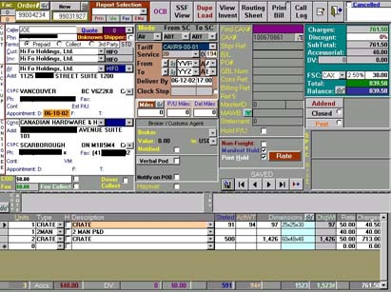
Interface Design
Notes:
Probably not real, but things that are real move closer to this endpoint than they should

Slide 5
Interface Design Goals
Supports all input and output use cases
Easy to learn
Easy to use
Efficient to use
Minimises data entry errors
Provides informative feedback on all relevant actions
Is visually appealing
Notes:
Database interface design is much easier than general application interface design because it is, for the most part, standardised.
As long as you make sure all the input and output use cases are supported
And as long as you follow basic sensible principles of screen layout, you’ll probably be ok
A good interface is and does…
We will look at each of these in detail

Slide 6
Interface Design
Supports all input and output use cases
Notes:
First and foremost, of course, you have to provide all the necessary functionality. If the user can’t enter all their data because you left off a critical text box, the database is broken, no matter how well-designed the screens.
This one is pretty straight-forward.
Presumably you have a validated list of I/O use cases
In an orderly fashion, go through the list making sure that each of them is provided for
Be especially careful about output cases, as they will often be overlooked in the RE stage
Consult client often and iterate.

Slide 7
Interface Design
Easy to learn and efficient to use
Use context-appropriate images and terms
Provide clear instructions where needed
Be consistent across screens
Ensure visibility
Notes:
In database design, these two things are tightly bound
If it is easy to learn, it is probably easy to use
Just a few basic principles – we will look at some examples of each, but generally:
Use context-appropriate images and terms
If you are using image icons, make sure they mean the same thing to your users as they mean to you
If you are working in a discipline/context that has a particular vocabulary, make sure that you use the correct vocabulary.
Provide clear instructions where needed
This isn’t just about a good help file, this is also about clear feedback (examples coming)
Be consistent across screens
If the user learns to something in a particular way on screen X, he should also be able to do it that way on screen Y. Otherwise he has to learn two ways instead of one.
Ensure visibility
This is a technical HCI term, and in this context it doesn’t mean “can be seen”.
Visibility = the user can tell what everything does and how it does it just by inspection
Let’s discuss some specifics…

Slide 8
Visibility
Ensure visibility
Use correct controls
Label all controls clearly
Choose icons carefully
Don’t hide functionality
Notes:
These are the sorts of things to be aware of
Examples to follow
Correct controls – don’t use radio buttons for multiple selects
Labeling -- correctly is harder than you might imagine….
Icons -- are tricky. Complex concepts don’t always fit nicely into 64x64 pixels.
Hidden functionality – context sensitive menus on right-click are great, but if the only way I can get something is by right-clicking (i.e. I can’t ever see a control for it), it’s hidden.

Slide 9
Use Correct Controls
Follow conventions
Notes:
Conventions
Radio buttons are mutually exclusive, checkboxes aren’t
Long lists should jump on a character being typed

Slide 10
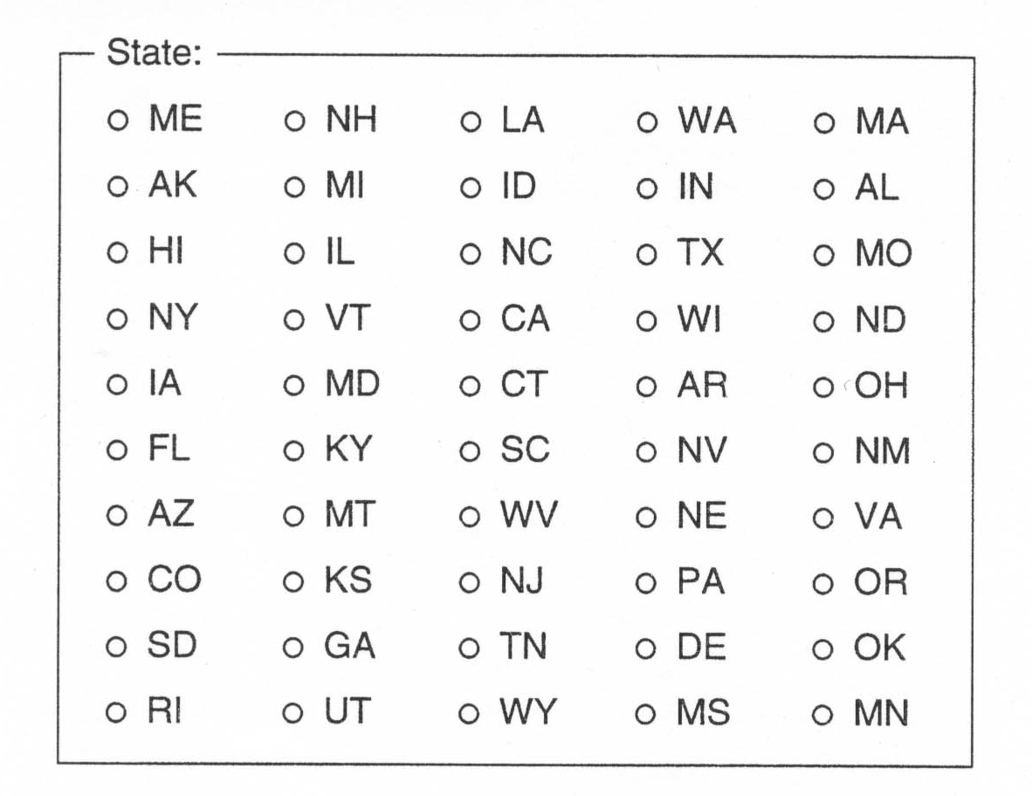
Use Correct Controls
Accommodate human information processing limitations
Notes:
Human information processing limitations
To do really accurate interface design, you actually need to know a lot about how the cognitive and visual systems work.
In this one, for example, there are too many items to perceive “all at once”. The brain pretty much tops out at 7 things.
So visual search is required. Visual search is slow.
And if you absolutely have to require it, organisation can make a big difference: here having the state names alphabetised would greatly speed the visual search.
But really the problem is that this is the wrong control. Radio buttons shouldn’t be used when there are more than half a dozen options.
Prefer some kind of list control.

Slide 11
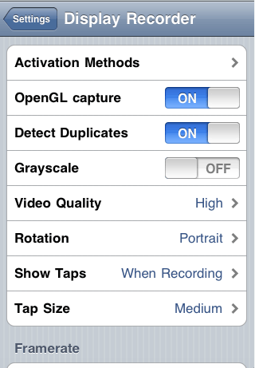
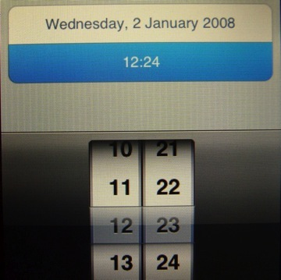
Use Correct Controls
Innovation is not sufficient
Notes:
Sometimes controls are hard for people to use.
The fact that they are kewl does not make up for this.
These are controls from the iPhone. I personally don’t like working with them
The spinny thing for setting time is annoying if you have to move it a long way. I’d prefer being able to enter the time
The little slidy on/off buttons I find very confusing. My first instinct is to want to press on the word On to turn the thing on. (Bad affordance.)
In actual fact, it is on, (Bad feedback) and if you want to turn it off, you slide the grey part to the left to hide On and reveal Off. (Just bad.)
I don’t care how slick they are, I don’t want to waste time interpreting them every time I have to change a setting.

Slide 12
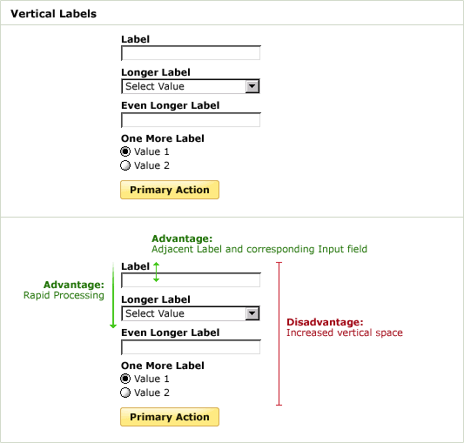
Labelling Controls
Notes:
You wouldn’t think this would be much of a problem, but it is
Let’s look at some examples.
Our goal is to put as much on the screen as we can (to reduce navigation time) while simultaneously minimising visual search, and making it absolutely clear what each field or control does (i.e. make the labeling obvious).
This layout – labels above fields - minimises eye movement and processing time, but wastes space

Slide 13
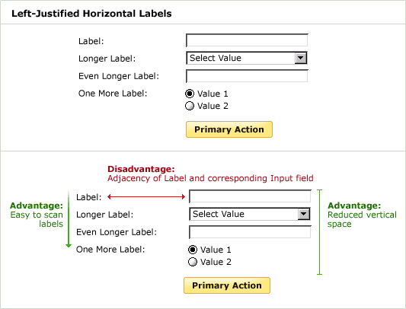
Labelling Controls
Notes:
Here – labels to the left -- the labels are easier for visual search, but the jump of the eye to the fields can be tricky

Slide 14
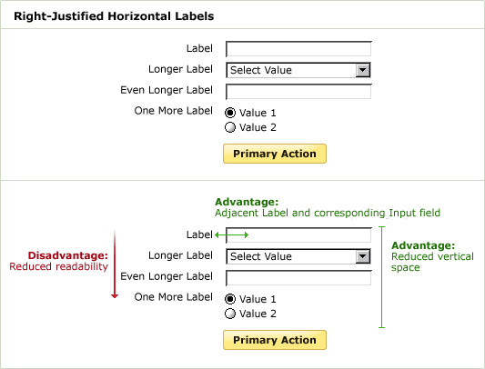
Labelling Controls
Notes:
Here the association of field and label is easy, but reading the labels is harder, because we are accustomed to finding the start (edge) of the line in the same place when reading.

Slide 15
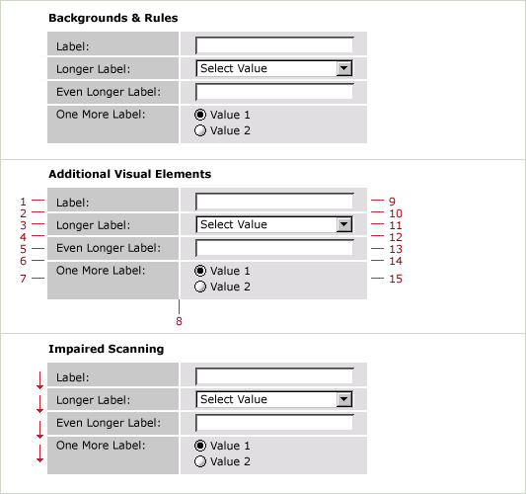
Labelling Controls
Notes:
You might try to improve the left-adjusted leap problem with dividing lines (rules)
But there is some evidence that every visual element slows processing
If you really wanted to know exactly which layout was best, you would need to do extensive task-based user testing, preferably collecting eye-tracking data.
In the absence of that, right-adjusting the labels and not over-filling the screens is best.

Slide 16
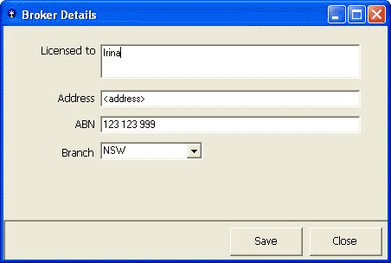
Labelling Controls
Notes:
And even when there’s no problem about where to put the labels, you have to be careful with what you call them...
We can assume that “ABN” is some context-appropriate vocabulary.
But what about those button labels? What does Close do?

Slide 17
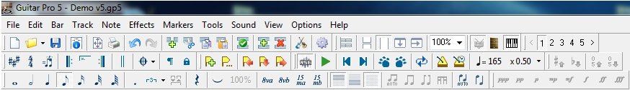
Icons

Slide 18


Icons

Slide 19
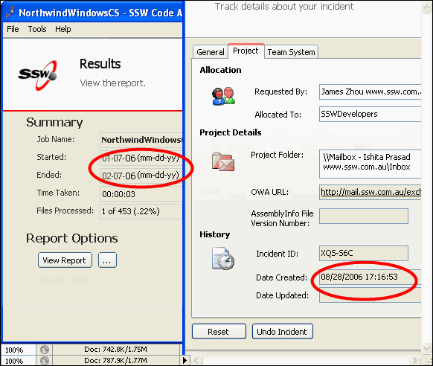
Consistency
Notes:
Consistency is extremely important, especially to learnability
It is an issue in things like layout, where we want to place controls in the same locations on every screen so the user isn’t having to hunt around, but there are also more subtle issues.
Inconsistent date formats
Consistency is extremely important, especially to learnability
Once a user learns that “dates should be like this”, it will be very annoying to suddenly make them different
Also be careful with terminology

Slide 20
Interface Design
Minimises data entry errors
Use selection whenever possible
Use input masks and other data validation checks
Ensure complete integrity constraints (including trigger where required)
Provide informative feedback in response to errors

Slide 21
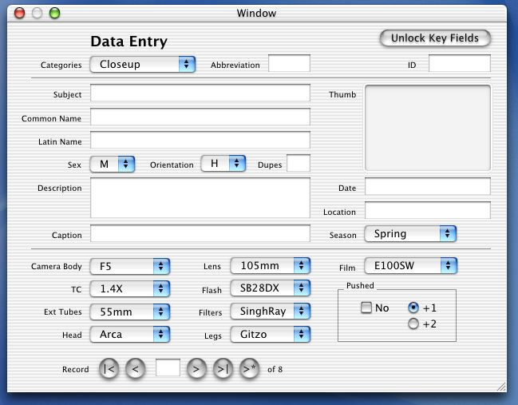
Selection Controls
Notes:
Drop downs for those hard-to-spell technical terms

Slide 22
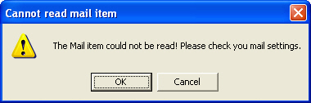
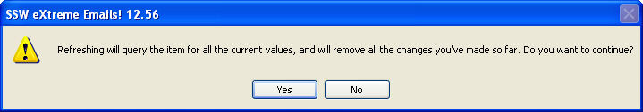
Feedback
Notes:
Bad and good feedback

Slide 23
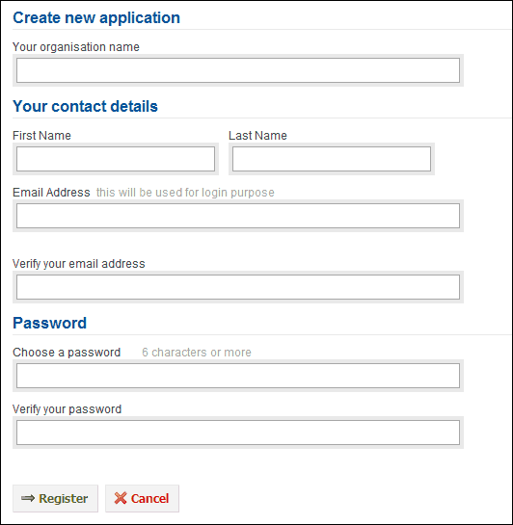
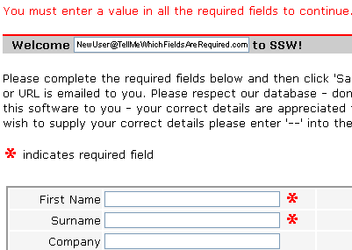
Feedback
Notes:
Feedback isn’t only for after. Here, we could have avoided an error with feedback in advance
If you have required fields, say so the first time

Slide 24
Interface Design
Avoid modal feedback when you can
Notes:
This one umbrellas all the others
The user needs to know that the system has understood his/her intention (like EFTPOS keypads)
The user needs to be informed if things are going to take a long time
The user needs to be informed about the results of actions
The user needs to be informed about errors, etc.
Don’t go so wild though that you get annoying (Access update row message, for example). See modal
If modal is what you’ve got, give options for turning it off

Slide 25
Interface Design
Efficient to use
Provide logically mapped navigation.
Organise commands and controls in groups that correspond to business operations
Organise lists alphabetically (or as appropriate)
Provide shortcuts for experienced users
Provide default values
Automatically insert copies of user-provided values where appropriate
Notes:
A number of things here
These are just some examples
Provide logically mapped navigation.
Imagine the Next button on the left and the Prev button on the right..
Organise commands and controls in groups that correspond to business operations
Reduces visual search, hand movement and page navigation
Organise lists alphabetically (or as appropriate)
Provide shortcuts for experienced users
Provide default values
Don’t make me enter something I don’t really need to enter
Automatically insert copies of user-provided values where appropriate
If you have several screens that use the same ID number, when I type it on screen 1, let the machine fill it in on all the other screens.

Slide 26
Interface Design
Is visually effective and appealing
Follow the Gestalt principles
Use colours informatively, not ornamentally.
Use text effects informatively, not ornamentally.

Slide 27
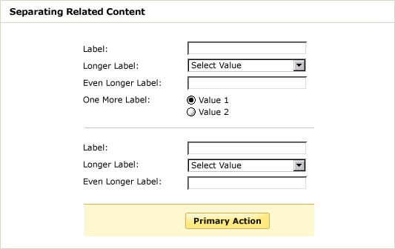
Informative Colour
Notes:
Here is an example
Lines and colours used here to indicate logical relationships, not to just make pretty

Slide 28
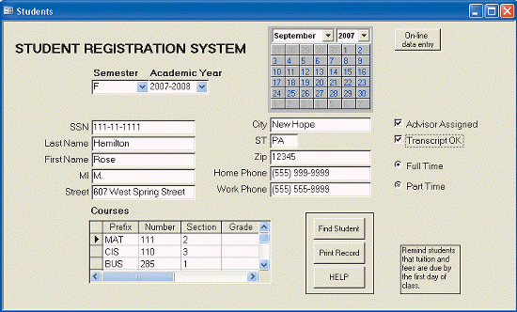
Layout
Notes:
Careful about not cluttering
Careful about not making groupings clear and logical
This screen has too much, and everything smushed together

Slide 29
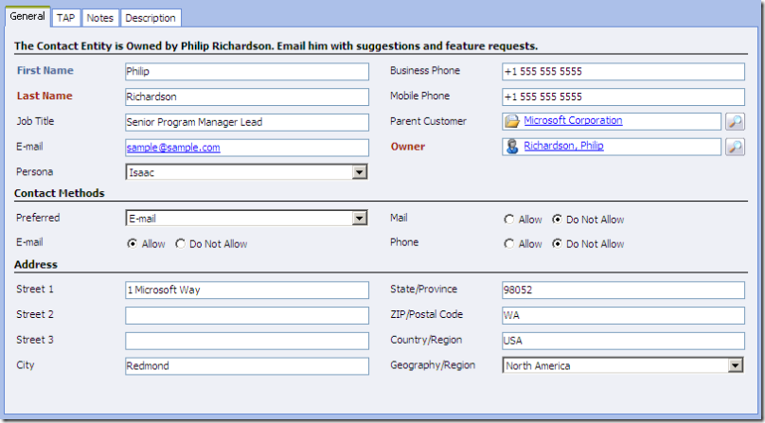
Layout
Notes:
Generally you want to 1) group things logically and 2) not put too much on the form so that it becomes cluttered
If available, tabbed control support both these goals. Just don’t go mad with tabs. Too many tabs is still cluttered.

Slide 30
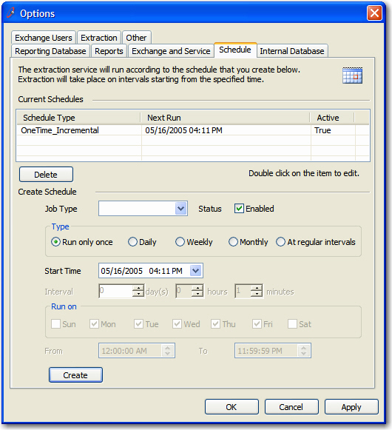
Layout
Notes:
Too much

Slide 31
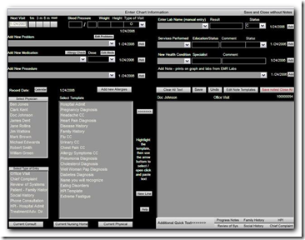
Layout
Notes:
The one-screen data entry design is convenient – no tabbing or scrolling
And you can stuff a lot on if you align and use colour.
Probably need some user-testing to tell if this is too much
In the end, that’s the only way to know if you’ve gotten it right
Test and iterate

